Slide 1
Angle Modulation (part one)
EE202
yanyan.wu@xjtlu.edu.cn
Department of Electronics and Electrical Engineering
Xi’an Jiaotong – Liverpool University

Slide 2
Contents
Definition of PM and FM
Properties of Angle-modulated Waves
Narrow Band FM
Broadband FM

Slide 3
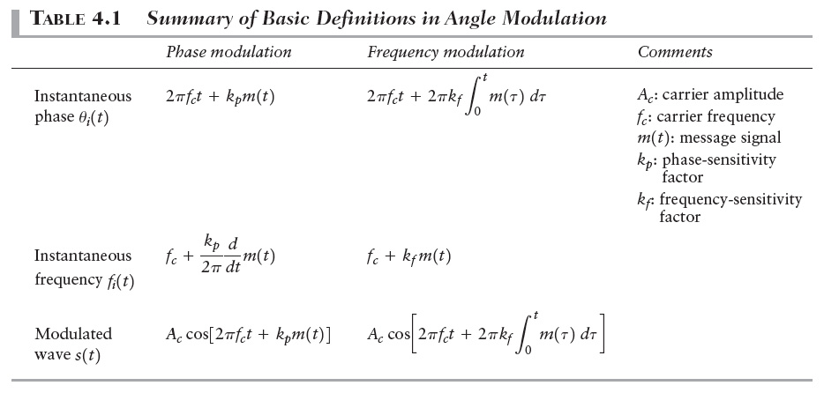
Definition of PM and FM

Slide 4
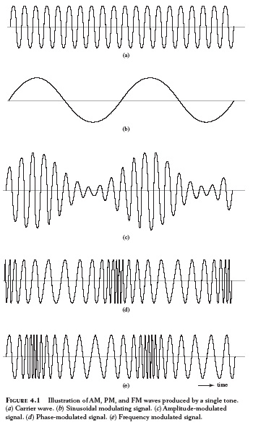
04_01

Slide 5
Properties of angle-modulated waves
Constancy of transmitted power
Non-linearity of the modulation process
Irregularity of the zero-crossing
Visualization difficulty of the message waveform
Tradeoff of the increased transmission bandwidth for improved noise performance
less sensitive to the presence of additive noise.

Slide 6

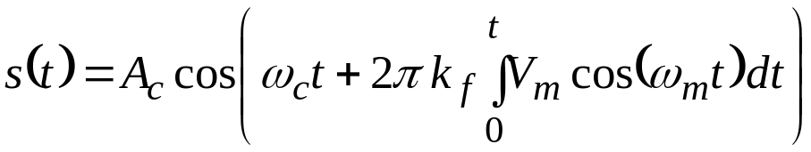
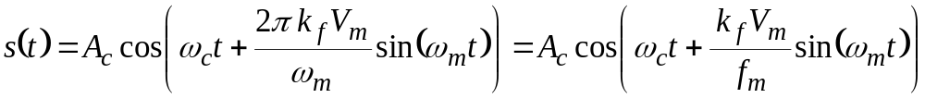


Analysis of FM
Suppose the base band signal m(t) is represented by a sinusoid with a frequency equal to its highest frequency Fourier component f_{m} and an amplitude V_{m} which equals the maximum voltage in m(t) :
The FM signal may then be written as:
We define the modulation index, β , as the maximum FM frequency
deviation divided by the base band bandwidth
Hence

Slide 7
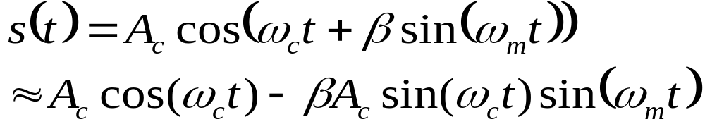
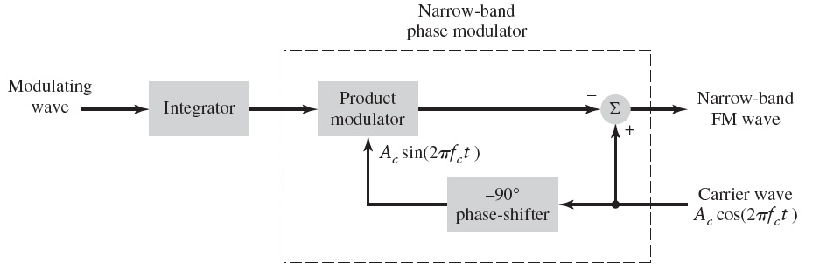
Narrow-band FM: β<<1
β<<1

Slide 8
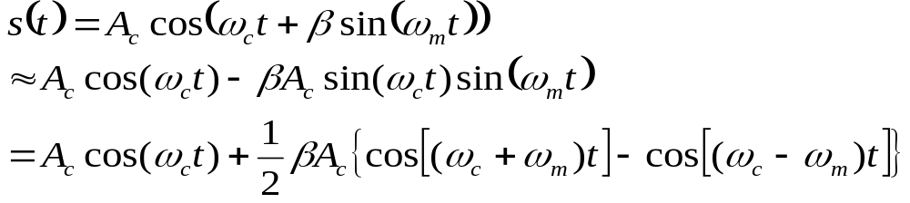
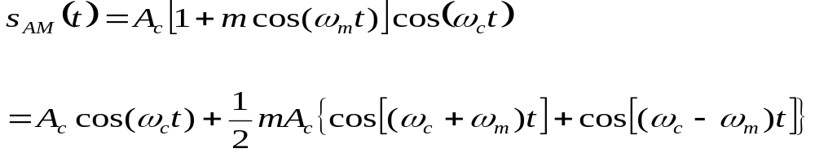
Class Activities
Compare narrowband FM and AM waves
The bandwidth of narrow band FM

Slide 9
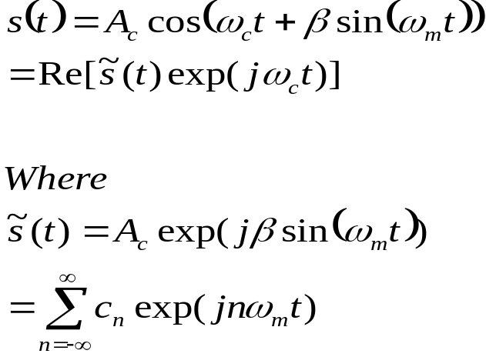
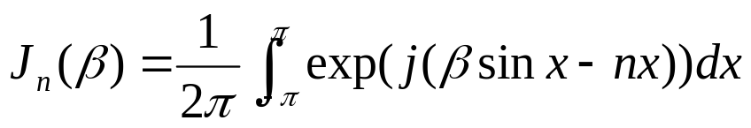

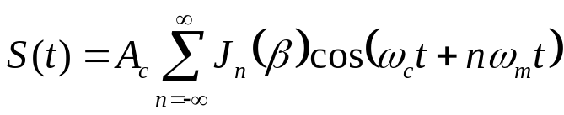
Broad-band FM: Bessel function expansion

Slide 10
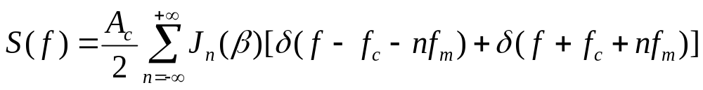
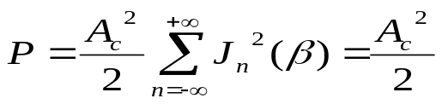
FM spectrum properties
The spectrum of the FM signal s(t) contains a carrier component and an infinite set of side frequencies located symmetrically about the carrier frequency.
When β<<1, J₀ (β)≈1, J₁(β) ≈ β/2, J_{n}(β) ≈ 0 (n>2), hence FM is effectively composed of carrier and a single pair of side –frequencies.
The average power of FM is

Slide 11
FM spectrum properties
The spectrum of the FM signal s(t) contains a carrier component and an infinite set of side frequencies located symmetrically about the carrier frequency.
J₀(β)
1
J₁(β)
J₂(β)
J₃(β)
0.5
J₄(β)
0
0
5
10
15
20
β
-0.5
Bessel functions J_{n}(β) of different order n

Slide 12
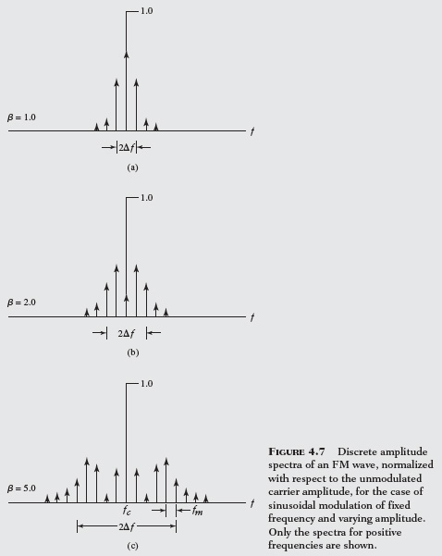
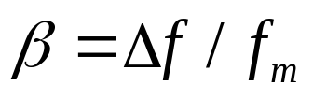
Illustration of FM Signal Spectra
Consider fm fixed, the variation of β results in two extremes of bandwidth representation .
When β>>1, B=2Δf
When β<<1, B=2f_{m}

